Slide 1


Ayman Eltalouny
Coordinator International Partnerships UN Environment
OzonAction International Partnerships with RAC Associations

Slide 2
Why Partnering with HVAC&R Associations
Accessibility to latest technological information and materials;
More closer to RAC stakeholders (industry and individuals);
Reliable and credible products and tools;
Quicker and timely support to clients;
Co-financing opportunities;
Address the needs of A5 countries through global HVAC&R initiatives; and
Strengthen MP agenda and strategic presence amongst different stakeholders.
Notes:
Adding a section on failures was one of the recommendations of the last CAG meeting.

Slide 3
Why Partnering and Objectives
UNEP - AHRI Initiative of Refrigerant Driving License (RDL)
Update on the cooperation with ASHRAE
UNEP- AREA Universal Training Kit
Other partnerships/Initiatives (IIR, EPEE, JRAIA)

Slide 4

Refrigerant Driving License
(RDL)

Slide 5
The Background

Slide 6
Driving Forces
Challenges: sound management of future refrigerants by the HVAC&R supply-chain network;
Difficulties: enforcing national/regional certification programs;
insuring level competencies + movement of HVAC&R
workforce;
Role and mandate of UNEP: support the policy and technical institutional setups linked to refrigerants management at national, regional and global levels + experience in implementing good-practice projects in more than 100 developing countries over last two decades;
AHRI well-positioned to coordinate global initiatives amongst industry associations as Secretariat for GRMI and ICHARMA; and
Serious willingness of industry to jointly address the challenge through common voice approach, for example GRMI

Slide 7
What is RDL?

Slide 8
Refrigerants Driving License (RDL)
Globally recognized and acceptable qualification program
  sets minimum requirements for the sound management of refrigerants by the Supply-Chain Network.
The qualification program to be developed, led and enforced by Industry as minimum requirements for business relationships.
NOT a replacement for existing national or regional certification scheme or role of governments.
Industry can play key role in advancing such global program especially in countries with no certification program.
Already UNEP received interest from several A5 governments to use RDL as their local certification program once developed.
Key word: A Joint Industry Approach

Slide 9
The Intention…
RDL is not intended to be a parallel certification program for the RAC servicing professions.
But…
A dedicated qualifications program Only for Sound Management of Refrigerants

Slide 10
Learning from Example… ECDL
1995 - CEPIS Task Force Creates ECDL Concept
In 1995, the Council of European Professional Informatics Societies (CEPIS) created a task force, supported by the European Commission. The new certification programme was launched as the European Computer Driving License (ECDL) in Sweden in August 1996.
1997 - ECDL Foundation Established
ECDL quickly gained European-wide acceptance, On the 8th January 1997, ECDL Foundation, a not-for-profit organization, limited by guarantee with no share capital, was formally established in Dublin, Ireland.
1999 - ICDL Introduced
As ECDL gained prominence in Europe, the number of candidates exceeded 1 million; this success attracted the attention of countries outside of Europe where the certification became known as ICDL (International Computer Driving License). Computer societies and international organizations in Africa and South America began promoting ICDL, and a milestone was reached in 1999, when UNESCO, through its Cairo office, signed an agreement with ECDL Foundation to become the national operator for several Arab States. Shortly afterwards, ICDL was launched in the North American and Asian markets.
2009 – Over 9 Million Candidates
2013 - Over 12 Million Candidates
2015 - Over 14 million Candidates

Slide 11
The Qualification Categories of RDL

Slide 12
Existing Refrigerant Qualification Programs (research is ongoing)
Identified the following technician certification programs as “sources” for the RDL:
Location | Name | Legal Requirements | Type of Certification | Other information
United States | EPA Section 608 | Mandatory certification | Tiers of certificaton
 | NATE | Voluntary certification | Certifications for specific topics
European Union | F Gas Regulations Certification | Mandatory certification | Tiers of certification
 | REAL Programs | Voluntary certifications | Certification for specific topics | Specializes in alternative refrigerants
South Africa | OTTC | Voluntary certification | Certifications for specific topics | Class on ammonia available
Japan | JARAC | Mandatory certification | Certification in separate categories
Brazil | FATEC | Voluntary certification | Tiers of certification
Colombia | ACAIRE | Voluntary certification | Tiers of certification
Australia | ARC | Mandatory certification | Licensing for different job functions | 3rd parties offer specialized alternative refrigerant training

Slide 13
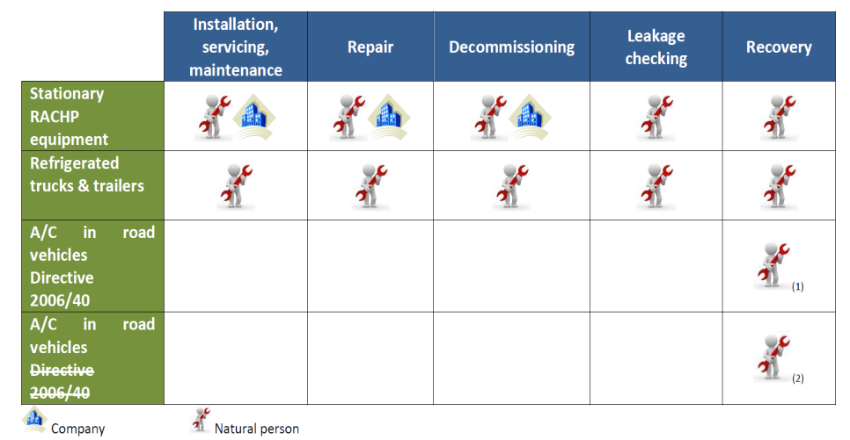
F-Gas Certification

Slide 14
Typical Certification Process vs. RDL
Competency (Qualification) Levels
Skills/Tasks Documentation
Training or Orientation
Testing
Evaluation and Certificates
RDL core mandate
Services that RDL can Endorse

Slide 15
Initial proposal for the RDL Qualification Categories
 |  | Individuals Categories |  |  | Enterprises Category
# | Requirements | (A) SMALL Applications | (B) Commercial A/C | (C) Commercial Refrigeration | (D) Large/Medium Enterprises
1 | Basic Knowledge (Environment, Refrigerants classifications/types, applications and relevant policies) | X | X | X
2 | Handling, transportation, storage and management of refrigerants’ containers | X | X | X
3 | Servicing skills of leak detection, R&R, evacuation, charging and system tightness | X | X | X
4 | Logging and Record Keeping |  | X | X | X
5 | Tools and equipment for the job | X | X | X | X
6 | Employment Skills, training and certification |  |  |  | X
Optional: Special Applications (later stage)
X | Special Applications: Ammonia Systems
Y | Special Applications: Carbon Dioxide Systems
Z | Special Applications: MAC
RDL- Residential Applications
RDL- Commercial A/C
RDL- Commercial Refrigeration
RDL- Enterprise

Slide 16
What’s Next?

Slide 17
Roadmap for RDL;
From development to launching
Stage-I: Development
Stage-II: Pilot
Stage-III: Launch and outreach
Development; documentation and operating modality
July 2017
Review and arrangements for the Pilot
Aug-Oct 2017
Piloting in 2-3 different regions/countries
4th Qrt 2017 – 2nd Qrt 2018
Revise, finalize and Launch
  3rd or 4th Qrt 2018

Slide 18
RDL Advisory Committee

Slide 19
Role of the Advisory Committee
Advisory committee members
ABRAVA, ACAIRE, AREA, EPEE, JRAIA, Refrigerants Australia, The Alliance, The Russian Union of Refrigeration Enterprises and ASHRAE
+ AHRI and UNEP as the Secretariat of RDL
The role of the advisory committee is:
Serve as the technical advising and review body for RDL through its different stages.
Ensure that suggested deliverables are inline with the objectives of the initiative and doesn’t conflict with existing certification scheme or institutional arrangements around the globe
Evaluate the work at different stages of the initiative and recommend and/or promote regions/countries to pilot RDL

Slide 20
Why Partnering and Objectives
UNEP - AHRI Initiative of Refrigerant Driving License (RDL)
Update on the cooperation with ASHRAE
UNEP- AREA Universal Training Kit
Other partnerships/Initiatives (IIR, EPEE, JRAIA)

Slide 21

ASHRAE- UNEP
Cooperation

Slide 22
ASHRAE – UNEP Cooperation; Background
Cooperation agreement signed in 2007
Why ASHRAE; ability to bring key industry experts under one roof, global confidence and acceptance for ASHRAE references plus ASHRAE presence in different countries regions (
Biennial work-plans established since 2009, recent one for 2017-2018 launched in Jan-2017
Many joint events and session organized jointly with ASHRAE
Liaison Committee established to ensure timely implementation and follow-up on the work plans and activities.

Slide 23
Main theme of 2017-2018 Work Plan
Working Beyond High-GWP Refrigerants
Main Goals
Actions
Advocacy and Knowledge Sharing
Global Conferences and Events
Refrigerants Awareness Package
Training, Education and Practice
Online Training Program on Refrigerants
Contemporary Learning Tools for Universities
Low- GWP Innovation Award Program
Assessment Program for RAC Plants

Slide 24

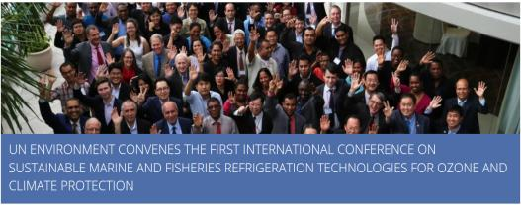
Example from the cooperation in conferences and events
International Conference on Sustainable Technologies of RAC in Marine/Off-Shore Fisheries Sectors, Bangkok- Thailand (April 2017)
International Conference on District Cooling for Urban Development, Sharm Al-Sheikh, Egypt (Sept 2017)
ASHRAE Developing Economies Conference, Delhi, India (Nov 2017)
Sixth International High Ambient Symposium, Dubai, UAE (March 2018)

Slide 25
ASHRAE- UNEP
Online Courses

Slide 26
ASHRAE- UNEP
Refrigerant Literacy Online Course
Target Audience
This course is targeted to non-specialists – such as NOUs, government officials, building owners, procurement officers and others as well as specialists with limited knowledge on refrigerants.

Slide 27
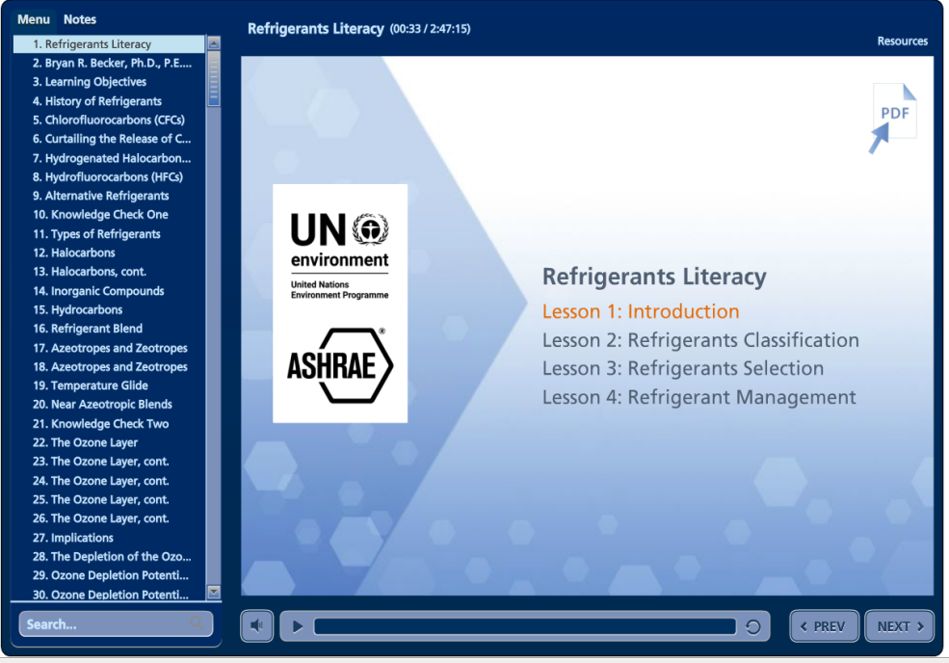

Slide 28
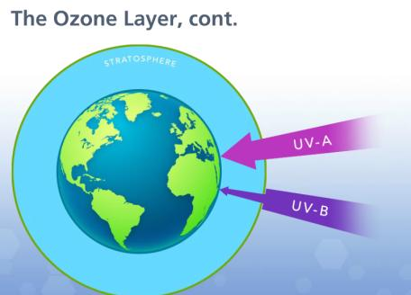
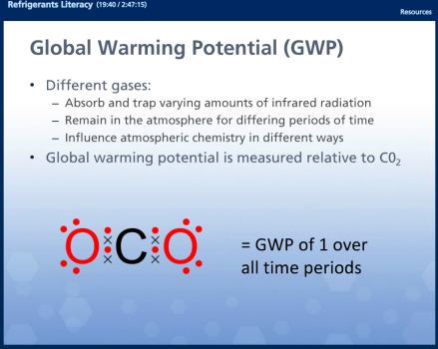
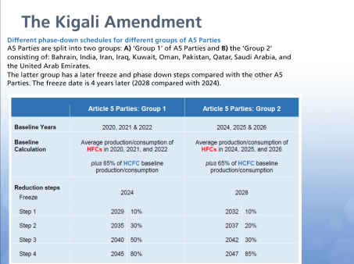
Lesson #1

Slide 29
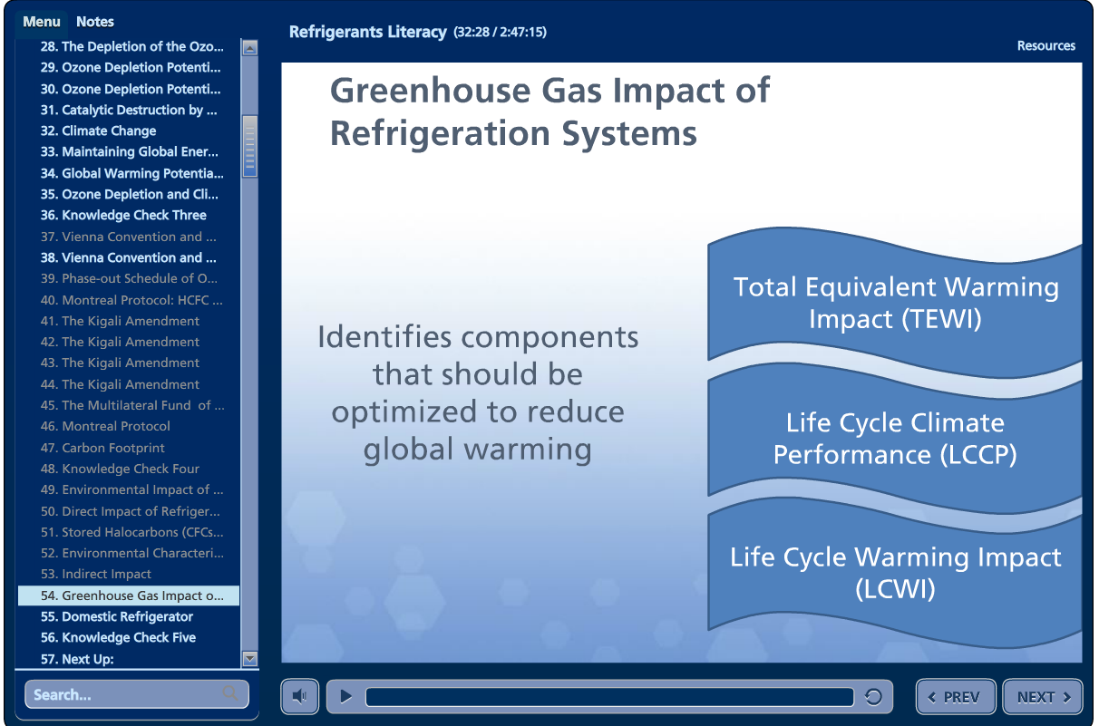

Slide 30
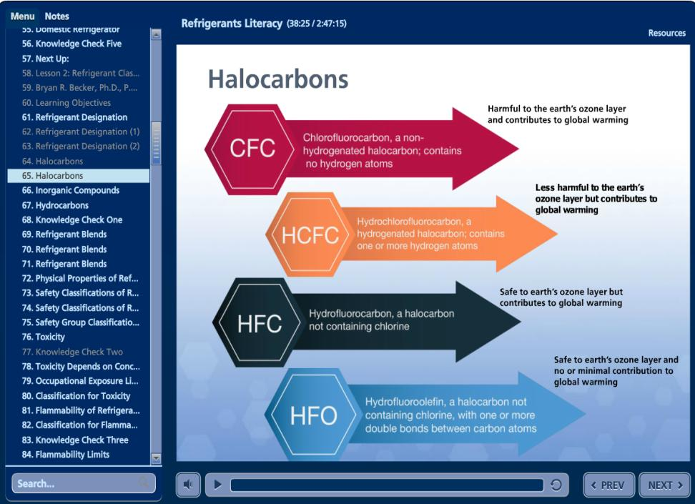
Lesson #2

Slide 31
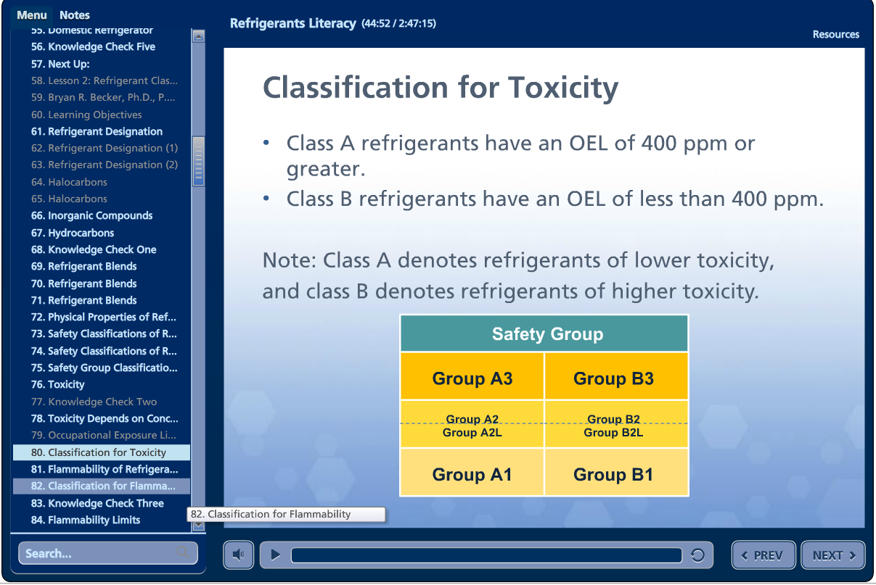

Slide 32
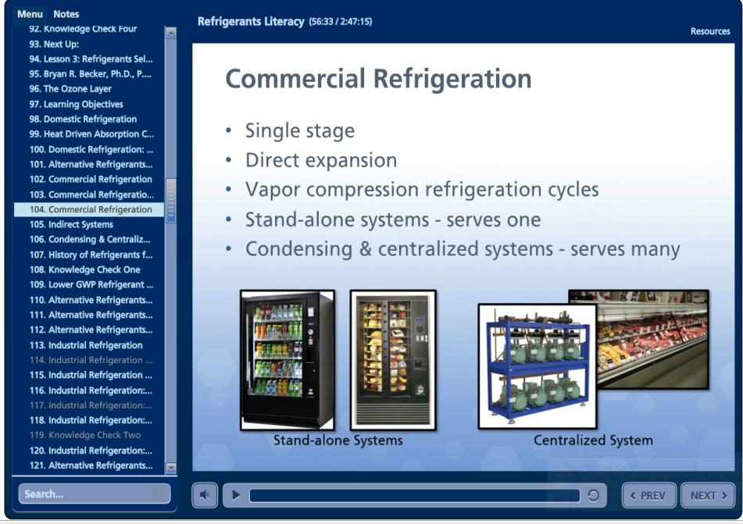
Lesson #3

Slide 33
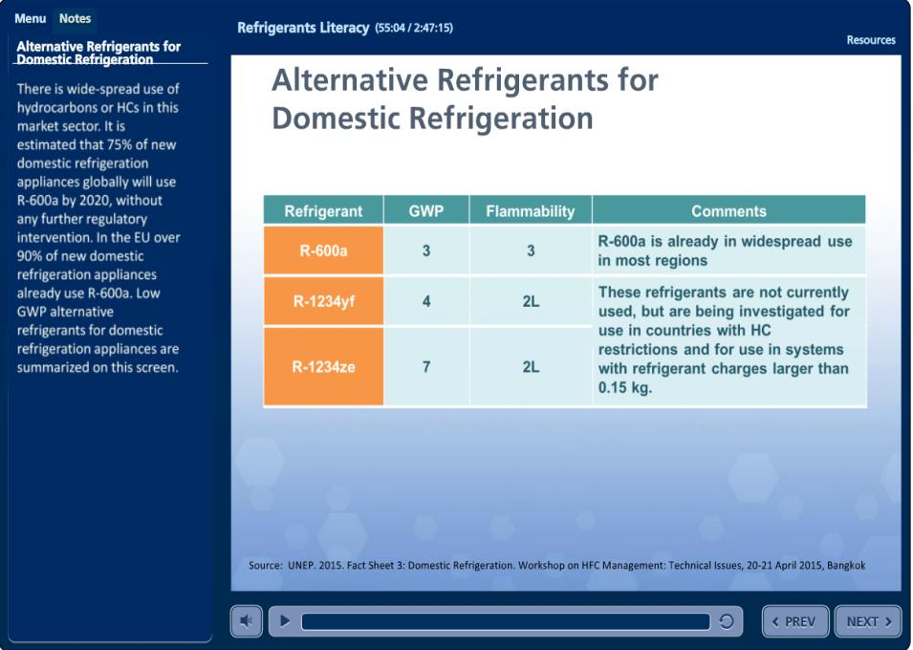

Slide 34
How to access the course
Official Launch is at OEWG-July 2017
Start Offering the course 1st July 2017, Special flyer with instructions will be circulated to all NOUs
Contact UNEP to get for enrolment ( Name, affiliation, contacts and email)
ASHRAE will send confirmation email with access code to the applicant
End of course certificate will be issued automatically upon passing the end of course exam (70% minimum)
No limit for repeating the exam

Slide 35
Next…
under development
ASHRAE- UNEP
Refrigerant Management Online Course
Target Audience
Engineers and Technicians dealing with refrigerants in design, production, installation, service and decommissioning of refrigeration and air-conditioning applications.
Planned to be completed by end of 2017

Slide 36
Why Partnering and Objectives
UNEP - AHRI Initiative of Refrigerant Driving License (RDL)
Update on the cooperation with ASHRAE
UNEP- AREA Universal Training Kit
Other partnerships/Initiatives (IIR, EPEE, JRAIA)

Slide 37

AREA-UNEP
Universal Training Kit on Alternative Refrigerants

Slide 38
AREA-UNEP
Universal Training Kit
Design a specialized “Universal Training Kit on Alternative Refrigerants” for the use of training institutes and centres in developing countries with the aim of offering state-of-art information and knowledge on the best practices and techniques in managing and handling future, mainly flammable, refrigerants in sound and safe manners by different stakeholders of the RSS sectors

Slide 39
AREA-UNEP
Universal Training Kit
What will be the format of the final materials
Pre-Assessment test (to be taken before the training start)
Post training assessment
Venue requirements for training (Equipment, Tools, Aids, Consumables, etc.)
Instructors minimum qualification
Guide for the instructor
Checklists and procedures to start and hold a training course
Supporting Syllabus, Textbook, Manuals, Tables, charts
PowerPoint [presentations for instructors
Hand-out Material for the attendees

Slide 40
Outline of the Course
 |  |  |  | SMALL MEDIUM Domestic/ light Commercial Workshops |  |  | Commercial A/C (Large Service Companies and Workshop) |  |  | Mobile A/C (MAC) |  | Commercial Refrigeration |  | Plants Operators and Managers
Module | Duration (hrs)* |  | T/P | Master Trainers |  | Technicians | Master Trainers |  | Technicians | Master Trainers | Technicians | Master Trainers | Technicians | Master Trainers | Engineers
1. General Module
Environmental & global policy background | 1 | T |  | x | x |  | x | x |  | x | x | x | x | x | x
Refrigerants Classification and Types | 1 | T |  | x | x |  | x | x |  | x | x | x | x | x | x
Lubricants for different refrigerant groups | 1 | T |  | x | x |  | x | x |  | x | x | x | x | x | x
Refrigerants selection for different applications | 2 | T |  | x | x |  | x | x |  | x | x | x | x | x | x
Identification, transport, storage and Safe handling of refrigerants and refrigerants containers | 2 | T/P |  | x | x |  | x | x |  | x | x | x | x | x | x
International and local policies | 1 | T |  | x | x |  | x | x |  | x | x | x | x | x | x
Standards and Codes | 1 | T |  | x |  |  | x |  |  | x |  | x | x | x | x
Labelling and Record Keeping | 1 | T |  | x |  |  | x |  |  | x |  | x | x | x | x

Slide 41
 |  |  |  |  | SMALL MEDIUM Domestic/ light Commercial Workshops |  |  | Commercial A/C (Large Service Companies and Workshop) |  |  | Mobile A/C (MAC) |  | Commercial Refrigeration |  | Plants Operators and Managers
# | Module | Duration (hrs)* |  | T/P | Master Trainers |  | Technicians | Master Trainers |  | Technicians | Master Trainers | Technicians | Master Trainers | Technicians | Master Trainers | Engineers
2 Hydrocarbons (Materials compatibility, specific components, specific relevant standards, identification, installation requirements, servicing* considerations, PPE and First Aid, safety checks for units and space, etc.)
A | Module of Use of R-290 in residential air-conditioning | 15 | T/P |  | x | x
B | Module of Use of R-290 in commercial air-conditioning | 15 | T/P |  | x | x |  | x | x
C | Module of Use of R-600a/R290 in domestic and light commercial refrigeration | 15 | T/P
3 Low-GWP HFC/HFO (Materials compatibility, specific components, specific relevant standards, identification, installation requirements, servicing* considerations, PPE and First Aid, safety checks for units and space, etc.)
A | Module of Use of HFC/HFOs in residential air-conditioning | 15 | T/P |  | x | x
B | Module of Use of HFC/HFOs in commercial air-conditioning | 15 | T/P |  |  |  |  | x | x
C | Module of Use of R-1234yf in Mobile Air-Conditioning units | 15 | T/P |  |  |  |  |  |  |  | x | x
D | Module of Use of HFC/HFOs in commercial/industrial refrigeration | 15 | T/P |  |  |  |  |  |  |  |  |  | x | x | x | x
E | Module of Use of HFC/HFOs in transport refrigeration*** | 15 | T/P |  |  |  |  |  |  |  |  |  | x | x | x | x

Slide 42
 |  |  |  |  | SMALL MEDIUM Domestic/ light Commercial Workshops |  |  | Commercial A/C (Large Service Companies and Workshop) |  |  | Mobile A/C (MAC) |  | Commercial Refrigeration |  | Plants Operators and Managers
# | Module | Duration (hrs)* |  | T/P | Master Trainers |  | Technicians | Master Trainers |  | Technicians | Master Trainers | Technicians | Master Trainers | Technicians | Master Trainers | Engineers
4 Maximizing Energy Efficiency in Servicing and Managing RAC Applications
A | Maximizing Energy Efficiency in Managing RAC plants | 10 | T |  |  |  |  |  |  |  |  |  |  |  | x | x
B | Maximizing Energy Efficiency in Servicing commercial air-conditioning | 5 | T/P |  |  |  |  | x | x
C | Maximizing Energy Efficiency in Servicing commercial refrigeration | 5 | T/P |  |  |  |  |  |  |  |  |  | x | x
5. Carbon Dioxide ****
6. Ammonia****

Slide 43

Other partnerships and Initiatives

Slide 44
Other partnerships and Initiatives
Model for alternatives Scenarios
Cooperation with EPEE for building a model for alternatives Scenarios
Model for Risk Assessment for Flammable Refrigerants
Under PRAHA-II implementation
Building risk assessment model for the logistics (installation, servicing, transportation, handling, etc.) of flammable refrigerants/systems
Sustainable Management of Cold Chain Sector
Several initiatives are being discussed with:
GFCCC on activities and programs that can be led by industry
In cooperation with JRAIA, CHEAA and AHRI
IIR on information and knowledge cold-chain kit
Involve research institutes in HAT countries
Pilot in 2 countries
IMO. FAO & others in relation to Marine and off-shore fisheries sectors
Potential model for LVCs (Servicing sector only)
Notes:
Adding a section on failures was one of the recommendations of the last CAG meeting.

Slide 45

University Course
Refrigerant Management
Special Course for Future Engineers

Slide 46
Background
Over the last two decades exhaustive training programmes was offered for the servicing technicians on the refrigeration good practices including emissions reduction and sound management of refrigerants.
These training programs offered also opportunity to field engineers to get involved but majority of the training recipients were field technicians.
The level of training programmes is always simplified to the minimum scientific level with more focus on hands-on practices and service techniques.
This course is an effort to support the engineering education process at different engineering institutes and colleges by acquainting the Future Engineers with the knowledge and skills required to manage refrigerants soundly as well as understand the technical and policy aspects associated with the refrigeration and air-conditioning industry
This special course is first of its kind, about refrigerants management, that offer comprehensive scientific information and knowledge suitable for the academic level
This effort is an upgrade and update of an earlier efforts offered by Kuwait University and American University in Beirut, almost 10 years ago, for similar course but more broader covering all ODS at that time.

Slide 47
Acknowledgement
In cooperation with the government of Lebanon represented by its National Ozone Unit (NOU) and the American University in Beirut (AUB), College of Engineering.
For the development of the course:
Prof. Nesreen Ghaddar, American University of Beirut
Prof. Fadl Moukalled, American University of Beirut
Prof. Walid Chakroun, Kuwait University
For review and comments to the course:
Prof. Essam E. Khalil, Egypt
Prof. Gurmohar Kochhar, Trinidad and Tobago
Mr. Michael Moller, Australia
Dr. Kwame Owusu-Achaw, Ghana
Mr. Sulkhan Suladze, Georgia
Dr. Prakob Surawattanawan, Thailand
The project was supervised by:
Dr. Shamila Nair-Bedouelle, Head, OzonAction Branch
Special thanks and appreciation to the support provided by:
Mr. Mazen Hussein, Head of National Ozone Unit, Lebanon
Ms. Joumana Samaha, Communication Officer, National Ozone Unit, Lebanon
Dr. Marissa Gowrie, National Ozone Unit, Trinidad and Tobago

Slide 48
Refrigerant Management
M1
M2
M3
M4
M5
Special University Course for Future Engineers

Slide 49
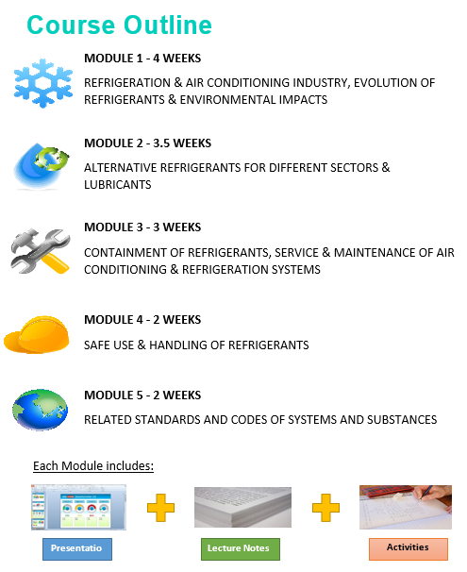

Slide 50
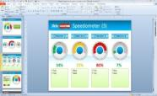


    Every Lesson contains:
Each Module includes:
Presentation
Lecture Notes
Activities
Engineering institutes and colleges are encouraged to benefit of this effort and use it in accordance to their internal academic structures.
The course is developed to ensure complying with international academic standards for similar engineering education.
Users of the course are also encouraged to keep abreast with the development at the global level in relation to environment and technology.
They are also advised to wisely use the course, or any part of it, in accordance to the local capacities and needs.

Slide 51
Ayman Eltalouny
Coordinator International Partnerships
OzonAction Programme
UN Environment
Manama - Bahrain
Mail address P. O. Box 10880
Tel.: +973-17812777 (main) or +973-17812765 (direct)
Fax: +973-17825110/1
Email: ayman.eltalouny@unep.org
Thank you

